Slide 1
A New Master Schedule for Tuxedo Schools
Goal:
To make the Tuxedo UFSD a “Top 100” school district

Slide 2
THE PROPOSED SCHEDULE CHECKS ALL THE BOXES:
Input... requests.. wish lists... came from:
The Superintendent/Central office
Scheduling committee
Teachers’ union
Community members
Board Of Education

Slide 3
Objectives: to be explained...
Academic rigor
No wasteful study halls! * [parent option]
More time for elective opportunities
Senior year options re: full schedules
Adheres to teacher contract
Reduced teacher preps per day
Sense of community
“Compatible” building schedules
A dynamite course catalogue to “sell”
This Photo by Unknown Author is licensed under CC BY-SA

Slide 4
Overriding objective...
Keep It Simple
&
Consistent!
(Virginia example:
“Cut the bells and whistles”)
This Photo by Unknown Author is licensed under CC BY-NC-ND

Slide 5
Before we begin... the “Great Debate” optimum period length; in my travels, I’ve seen ‘em all.
37
42
48
55
80

Slide 6
“DRUM ROLL, PLEASE!”
Features of the proposed schedule for Tuxedo

Slide 7
Please-- hold questions...
...until I complete the presentation.
(I may answer them along the way!)

Slide 8
Features of the new master schedule
nine-period day
students fully–scheduled with NO STUDY HALLS*
additional tenth “flex” period in the afternoon for a variety of activities/classes
all periods are the same length in the nine-period day; 37-minute periods are gone
four 48-minutes periods each week (one “drops out” in a five-day schedule) =“academic rigor”
less wasteful start-up/shut-down time
opportunities for interdisciplinary instruction & team teaching
periods rotate to break the lockstep of same schedule day in, day out
day numbers (or letters) replace days of the week– important re: holidays, closings
schedule is compatible with GGM
schedule is compatible with teachers’ contract
teacher preps are a maximum of four each day, some days fewer
daily “advisories” have been embedded in the schedule (30 minutes)
provision for community-building programs by shortening periods as needed
on the horizon: increased elective offerings -- “platforming”
also on the horizon: “arena/arena by exception” student self-scheduling

Slide 9
Time!
7 x 48” + 30” =366”
366x180=65,880/60=1,098
We exceed the State minimum.
This Photo by Unknown Author is licensed under CC BY-NC

Slide 10
Icing on the cake: A major selling point!
small class sizes
This Photo by Unknown Author is licensed under CC BY

Slide 11
Study Halls???
All students are FULLY scheduled...
...unless PARENTS opt to have a study hall in their students’ schedule.
This Photo by Unknown Author is licensed under CC BY-NC-ND

Slide 12
Advanced/College-Level Courses
AP English Language
AP Psychology
AP Government
AP Math
AP Statistics
AP Biology
AP Physics
Marist College Spanish 101
AP Music Theory

Slide 13
The 10th period: “flex/floating”
.5 electives
extra help
meeting time
common planning time
conference time
(and more tbd)
This Photo by Unknown Author is licensed under CC BY-SA-NC

Slide 14
TYPICAL* 9th GRADE SCHEDULE nine-period day with NO study halls!
English (ELA9)
Social Studies (Global I)
Math (Algebra)
Science (Living Environment)
World Language (Spanish II)
Science lab/Phys Ed. (Liv. Env. Lab/Phys. Ed.)
Freshman Foundations (Design & Ethics)
Elective (Fundamentals of Art)
Pathway Elective – choice: (ELA, Science, Art, Music, Video/Robotics)
Lunch

Slide 15
TYPICAL 10th GRADE SCHEDULE nine-period day with NO study halls!
English (ELA 10)
Social Studies (Global II)
Math (Geometry)
Science (Earth Science)
World Language (Spanish III)
Science lab/Phys Ed. (Earth Science Lab/Phys. Ed.)
Sophomore seminar (Health & College/Career Readiness)
Pathway elective choice: (ELA, Science, Art, Music, Video/Robotics)
Pathway elective choice: ( ELA, Science, Art, Music, Video/Robotics)
Lunch

Slide 16
TYPICAL 11th GRADE SCHEDULE nine-period day with NO study halls!
English (ELA 11)
Social Studies (United States History)
Math (Algebra II)
Science (Chemistry)
World Language (Marist College Spanish I01)
Science Lab/Phys. Ed. (Chemistry Lab/Physical Education)
Elective Choice: (Psychology and Astronomy)
Elective Choice: (STEM Job Shadowing)
Elective Choice: (AP Music Theory)
Lunch

Slide 17
TYPICAL 12th GRADE SCHEDULE nine-period day with NO study halls!
English (ELA12)
Social Studies (Government/Economics)
Math (Pre- Calculus)
Science (AP Psychology)
Elective choice (Graphic Communications & Robotics)
Elective choice (Journalism)
Elective choice (AP Statistics)
STEM Internship
Additional Elective –or– Study Hall (parent option)
Lunch

Slide 18
TYPICAL CORE TEACHER’S SCHEDULE: MATH
TEACHER A
Math 7
Algebra
Geometry
Algebra Extended A
Mathematical Concepts
TEACHER B
Math 8
Algebra II
Pre-Calculus
College Math
AP Calculus

Slide 19
SPECIAL EDUCATION
Classes will parallel (dovetail) the mainstream master schedule.
Foster the abilities to increase in-district programs
This Photo by Unknown Author is licensed under CC BY-NC-ND

Slide 20
To repeat...
Tuxedo’s goal:
“Make us a Top 100 School district”
This Photo by Unknown Author is licensed under CC BY-NC-ND

Slide 21
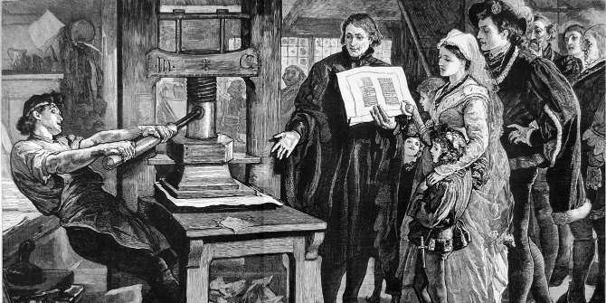
This overhaul is a multiyear work in progress
This model is a “living document”
and we will continue to develop enhancements for the future.
This Photo by Unknown Author is licensed under CC BY
This Photo by Unknown Author is licensed under CC BY-SA

Slide 22
We’re very close...
...to crossing the finish line.
One item on my wish list:
Business Education teacher
Music teacher
This Photo by Unknown Author is licensed under CC BY-NC

Slide 23
However... ...don’t let it be our little secret!
We’re producing a dy-na-mite course catalogue to let the world know what we’re doing!

Slide 24
Questions? Comments??
Dr. “Steve” Kussin
sk3015@aol.com
This Photo by Unknown Author is licensed under CC BY

